Slide 1
DDR5_DQ_Write_Protocol (BIRD 147/201)
Walter Katz
IBIS-ATM
July 28, 2020

Slide 2
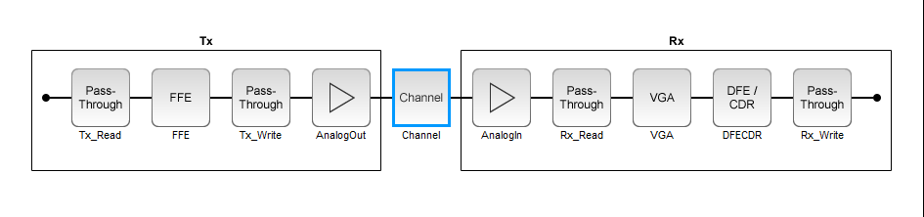
General BCI Flow (BIRD 147/201)
Tx_Read BCI_Parameters_In is Rx BCI_Parameters_Out
Tx_Write makes Tx BCI_Parameters_Out
Rx_Read BCI_Parameters_In is Tx BCI_Parameters_Out
Rx_Write makes Rx BCI_Parameters_Out
If BCI_State is still “Training” then go to Step 1 above.
(Note, BIRD 147 communications use file I/O, BIRD 201 communicates use **BCI_Parameters_Out and *BCI_Parameters_In)

Slide 3
I Am Proposing Two DDR5_DQ_Write Protocols
DDR5_DQ_Write_JEDEC
  Tx communicates to Rx DFE tap indices, and requested BER
  Rx communicates to Tx DFE tap indices used, DFE tap coeficients used and metrics from Rx impulse_response output
DDR5_DQ_Write_Generic
  Tx communicates to Rx DFE tap coefficient, and requested BER
  Rx communicates to Tx DFE tap indices used, DFE tap coeficients used and metrics from Rx impulse_response output

Slide 4
What the Tx Tells the Rx Each Time
(DDR5_DQ_Write_JEDEC_Tx
  (BER_Requested 1.e-5)
  (Gain_Register 4)
  (VrefDQ_Register 35)
  (DFE_Index (1 4) (2 1) (3 4) (4 3))
)
(DDR5_DQ_Write_Generic_Tx
  (BER_Requested 1.e-5)
  (Gain_Value 1.2)
  (VrefDQ_Value 0.8)
  (DFE_Coefficient (1 -.3) (2 .05) (3 .04) (4 .03))
)

Slide 5
What the Rx Tells the Tx Each Time
(DDR5_DQ_Write_JEDEC_Rx
  (BER_Used 1.e-5)
  (Gain_Value 1.2)
  (VrefDQ_Value 0.8)
  (DFE_Index (1 4) (2 1) (3 4) (4 3))
  (DFE_Coefficient (1 -.3) (2 .05) (3 .04) (4 .03))
  (Metric (Height .055)(Width 120.e-12)(Area 5.e-12)(COM 14.7))
)
(DDR5_DQ_Write_Generic_Rx
  (BER_ Used 1.e-5)
  (Gain_Register 4)
  (Gain_Value 1.2)
  (VrefDQ_Register 35)
  (VrefDQ_Value 0.8)
  (DFE_Index (1 4) (2 1) (3 4) (4 3))
  (DFE_Coefficient (1 -.3) (2 .05) (3 .04) (4 .03))
  (Metric (Height .055)(Width 120.e-12)(Area 5e-12)(COM 14.7))
)

Slide 6
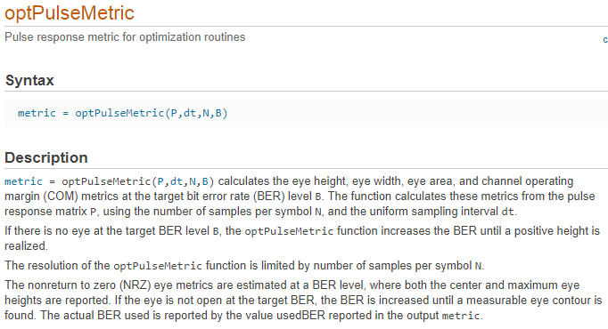
optPulseMetric: MATLAB Function That Calculates Standard Metrics From A Pulse Response. MathWorks Plans To Put This Algorithm and MATLAB Code In Public Domain

Slide 7
Next Steps
IBIS has left open how BCI Protocols are:
  Published
  Approved
  Amended
I would like to proceed by documenting these two protocols, working out the document in IBIS-ATM, and publishing the document in the Open Forum.
The Open Forum will decide if it just “posts” BCI protocols or agree to a mechanism to approve BCI protocols.

